Slide 1
Chapter 6
Long-Term Memory: Structure
Notes:
Hi Everyone: This video is the first of two covering long-term memory. In this chapter, we’ll cover the structure and organization of LTM. Then in Chapter 7, we’ll get more into how information is stored and retrieved from LTM

Slide 2
Long-Term Memory (1 of 2)
“Archive” of information about past events and knowledge learned
Works closely with working memory
Storage stretches from a few moments ago to as far back as one can remember
More recent memories are more detailed
Notes:
Memories decay overtime – gradual shift from highly detailed to less detailed

Slide 3
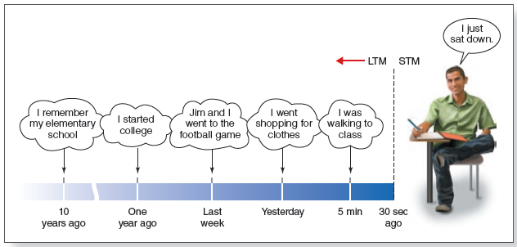
Long-Term Memory (2 of 2)
Notes:
Figure 6.1 Long-term memory covers a span that stretches from about 30 seconds ago to your earliest memories. Thus, all of this student’s memories, except the memory “I just sat down” and anything the student was rehearsing, would be classified as long-term memories.

Slide 4
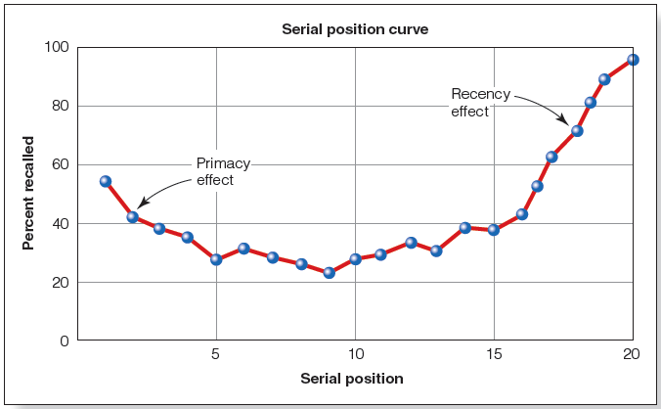
Serial Position (Murdoch, 1962)
Distinction between short-term and long-term memories using the serial position curve
Read stimulus list, write down all words remembered
Notes:
Figure 6.3 Serial position curve (Murdoch, 1962). Notice that memory is better for words presented at the beginning of the list (primacy effect) and at the end (recency effect).

Slide 5
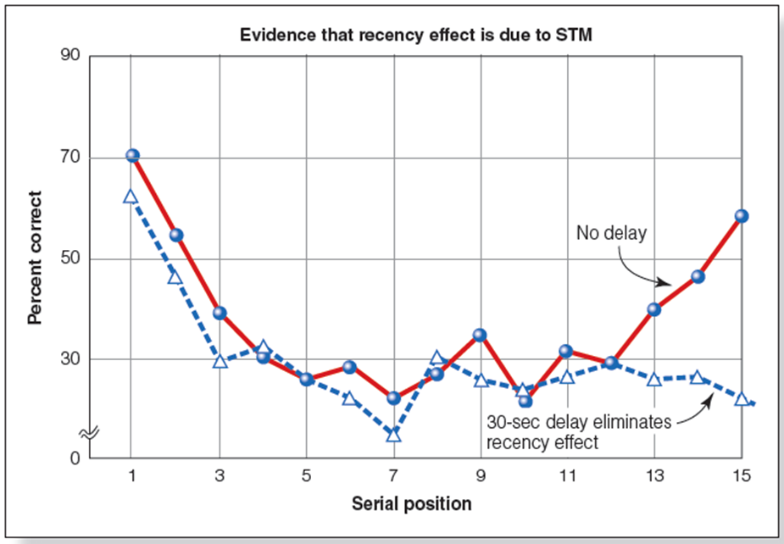
Serial Position Curve
Notes:
Memory better for stimuli presented at end of list
Recency effect: Stimuli still in STM
Figure 6.5 Results of Glanzer and Cunitz’s (1966) experiment. The serial position curve has a normal recency effect when the memory test is immediate (solid red line), but no recency effect occurs if the memory test is delayed for 30 seconds (dashed blue line).

Slide 6
Coding in Short-Term and Long-Term Memory
Visual and auditory encoding in short- and long-term memory
Semantic encoding in short- and long-term memory
  Wickens et al. (1976)
  Interference enhanced by meanings of words

Slide 7
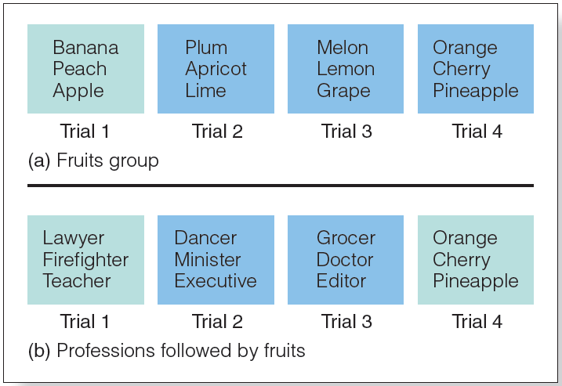
Coding in Short-Term Memory
Notes:
Figure 6.6 Stimuli for the Wickens et al. (1976) experiment. (a) Subjects in the Fruits group are presented with the names of three fruits on each trial. After each presentation, subjects counted backwards for 15 seconds and then recalled the names of the fruits. (b) Subjects in the Professions group were presented with the names of three professions on trials 1, 2, and 3, and with the names of three fruits on trial 4. They also counted backwards for 15 seconds before recalling the names on each trial.

Slide 8
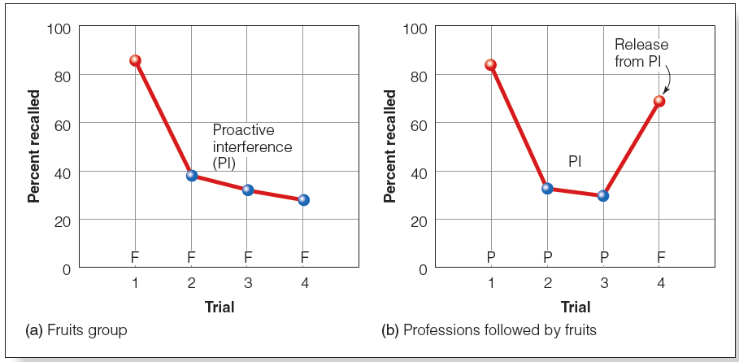
Semantic Coding in Short-Term Memory
Notes:
Figure 6.7 Results of the Wickens et al. (1976) proactive interference experiment. (a) The Fruits group showed reduced performance on trials 2, 3, and 4, caused at least partially by proactive interference (indicated by blue points). (b) The Professions group showed similarly reduced performance on trials 2 and 3. The increase in performance on trial 4 represents a release from proactive interference because the names of fruits, rather than professions, were presented on trial 4.

Slide 9
Coding in Long-Term Memory
Semantic coding in long-term memory
Recognition memory: identification of a previously encountered stimulus
Sachs (1967):
  Participants remember wording versus meaning?

Slide 10
Examples of Coding in Short-Term and Long-Term Memory
Code | Short-Term Memory | Long-Term Memory
Visual | Holding an image in the mind to reproduce a visual pattern that was just seen (Della Sala et al., 1999.) | Visualizing what the Lincoln Memorial in Washington, D.C., looked like when you saw it last summer
Auditory | Representing the sounds of letters in the mind just after hearing them (Conrad, 1964) | Repeating a song you have heard many times before, over and over in your mind
Semantic | Placing words in an STM task into categories based on their meaning (Wickens et al., 1976) | Recalling the general plot of a novel you read last week (Sachs)

Slide 11
Locating Memory in the Brain
Neuropsychology
HM > surgery removed hippocampus
  Retained short-term memory (STM) but unable to transfer info to long-term memory (LTM)
  Unable to form new LTMs
KF > accident damaged parietal lobe
  Impaired STM (reduced digit span) but functional LTM
  Able to form and hold new memories

Slide 12
A Double Dissociation for STM and LTM
PATIENT | SHORT-TERM MEMORY | LONG-TERM MEMORY
H.M. and Clive Wearing | OK | Impaired
K.F. | Impaired | OK

Slide 13
Episodic and Semantic Memory
Episodic memory involves mental time travel
  Tied to personal experience; remembering is reliving
  “Self-knowing”
Semantic memory does not involve mental time travel
  General knowledge, facts
  “Knowing”

Slide 14
Separation of Episodic and Semantic Memories (1 of 2)
KC > damaged hippocampus
  No episodic memory, cannot relive past events
  Semantic memory intact, can remember general information about the past
Italian woman
  Impaired semantic memory
  Episodic memory intact, can remember past events and create new event memories

Slide 15
A Double Dissociation for Semantic and Episodic Memory
PATIENT | SEMANTIC MEMORY | EPISODIC MEMORY
K.C. | OK | Poor
Italian woman | Poor | OK

Slide 16
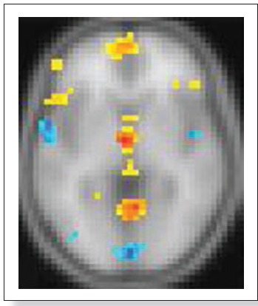
Separation of Episodic and Semantic Memories (2 of 2)
fMRI demonstrates that retrieving episodic and semantic memories activate different areas of the brain
Notes:
Figure 6.9 Brain showing areas activated by episodic and semantic memories. The yellow areas represent brain regions associated with episodic memories; the blue areas represent regions associated with semantic memories.

Slide 17
Episodic and Semantic Memory Interaction
Episodic can be lost, leaving only semantic
  Acquiring knowledge may start as episodic but then “fade” to semantic
Semantic can be enhanced if associated with episodic
  Autobiographical memory: specific experiences, includes semantic and episodic
  Personal semantic memory: semantic memories that have personal significance

Slide 18
Types of Long-Term Memory (1 of 2)
Type | Definition | Example
Episodic | Memory for specific personal experiences, involving mental time travel back in time to achieve a feeling of reliving the experience. | I remember going to get coffee at Le Buzz yesterday morning and talking with Gil and Mary about their bike trip.
Semantic | Memory for facts. | There is a Starbucks down the road from Le Buzz.
Autobiographical | People’s memories for experiences from their own lives. These memories have both episodic components (relived specific events) and semantic components (facts related to these events). These semantic components of autobiographical memory are personal semantic memories. | I met Gil and Mary at Le Buzz yesterday morning. We sat at our favorite table near the window, which is often difficult to get in the morning when the coffee shop is busy.

Slide 19
How Time Affects Memories (1 of 2)
Forgetting increases with longer intervals after encoding
Forgetting is not an “all-or-nothing” process!
  Familiarity: semantic memory (know)
  Recollection: episodic memory (remember)
Remember/Know procedure
  Semanticization of remote memories
Loss of episodic details for memories of long-ago events

Slide 20
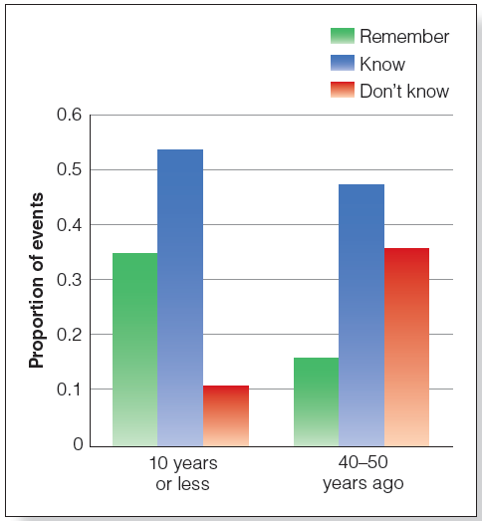
How Time Affects Memories (2 of 2)
Notes:
(Figure 6.10 Results of the remember/know experiment that tested older subjects’ memory for events over a 50-year period.

Slide 21
Memory and the Future
Constructive episodic simulation hypothesis
  Episodic memories are extracted and recombined to create simulations of future events
  Helps us to anticipate future needs and guide future behaviors
  Adaptive function similar to mind wandering
Notes:
Can memory influence the future?

Slide 22
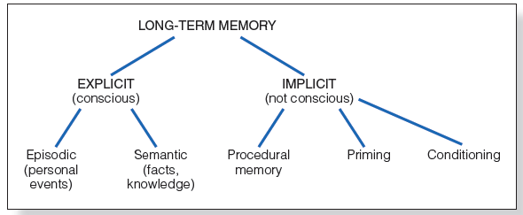
Types of Long-Term Memory
Notes:
Figure 6.14 Long-term memory can be divided into explicit memory and implicit memory. We can also distinguish between two types of explicit memory, episodic and semantic. There are a number of different types of implicit memory. Three of the main types are procedural memory, priming, and conditioning.

Slide 23
Implicit Memory
Implicit memory
  Occurs when learning from experience is not accompanied by conscious remembering
Procedural memories
Priming
Conditioning
Notes:
“automatic processes”

Slide 24
Procedural Memory
Skill memory: memory for actions
No memory of where or when learned
Perform procedures without being consciously aware of how to do them
People who cannot form new LTMs can still learn new skills (e.g., HM)

Slide 25
Priming
Priming
  Presentation of priming stimulus changes person’s response to a test stimulus
Repetition priming
  Test stimulus the same or similar to priming stimulus
  Called implicit memory; person may or may not remember original presentation of priming stimuli
Graf et al. (1985)

Slide 26
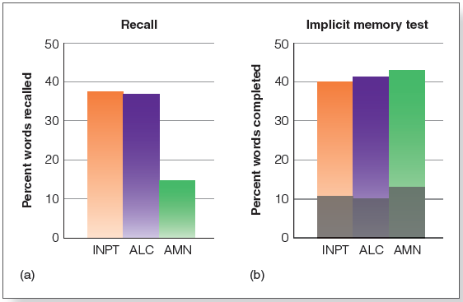
Repetition Priming
Notes:
Figure 6.17 In the Graf et al. (1985) experiment, (a) amnesiac patients (AMN) did poorly on the recall test compared to the medical inpatients (INPT) and the alcoholic controls (ALC). (b) Amnesiac patients did as well as the other patients on the implicit memory test (completing three-letter word stems). The gray areas on each bar indicate performance on words the participants hadn’t seen earlier.

Slide 27
Priming in Everyday Experience
Perfect and Askew (1994)
  Propaganda effect: more likely to rate statements read or heard before as being true
  Involves implicit memory because it can occur when people are not aware of previously seeing or hearing statement
  Implications for advertisements

Slide 28
Classical Conditioning and Implicit Memory
Pairing a neutral stimulus with a reflexive response
Involves implicit memory when person has forgotten about original pairing of the stimulus and the response

